Slide 1

Chapter 11
DISCOVERING REQUIREMENTS

Slide 2
Overview
The importance of requirements
Different types of requirements
Data gathering for requirements
Bringing requirements to life
Personas
Scenarios
Capturing interaction with user cases

Slide 3
What, how and why?
What is the purpose of the requirements activity?
Explore the problem space
Establish a description of what will be developed
How to capture requirements once discovered
In prototypes or operational product
Through structured or rigorous notations
Different capturing mechanisms emphasize and de-emphasize different aspects

Slide 4
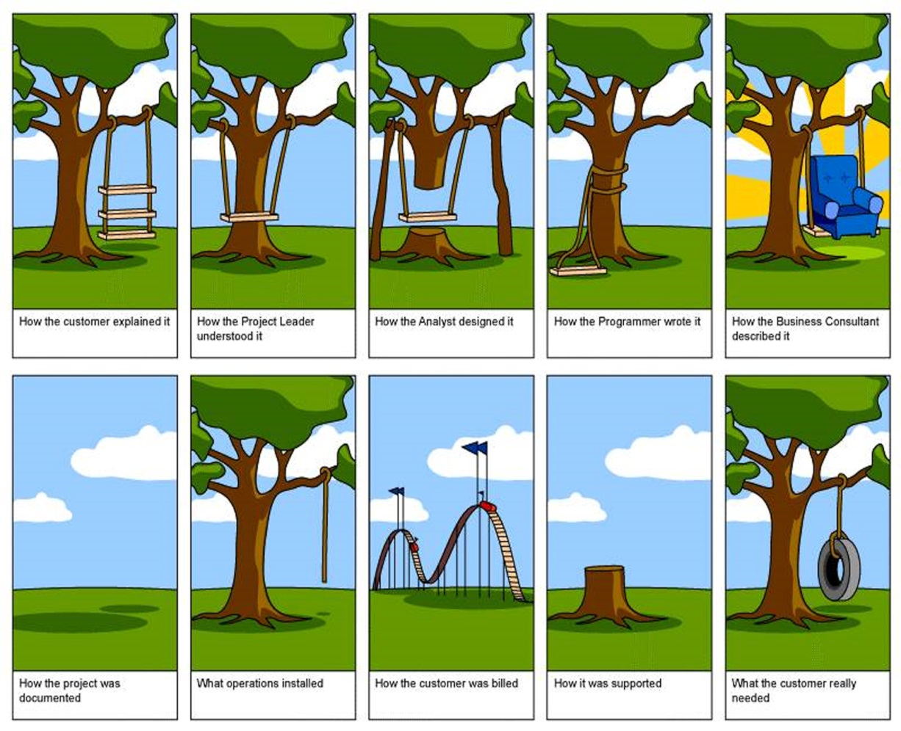
Why bother?
Requirements activity is the stage where miscommunication occurs most commonly
4

Slide 5
What are requirements?
A statement about an intended product that specifies what it is expected to do or how it will perform
Different forms and different levels of abstraction
User stories (most prevalent in agile development contexts)
Format:
As a <role>, I want <behavior> so that <benefit>
Example user stories for a travel organizer might be:
As a <traveler>, I want <to save my favorite airline for all my flights> so that <I will be able to collect air miles>
As a <travel agent>, I want <my special discount rates to be displayed to me> so that <I can offer my clients competitive rates>

Slide 6
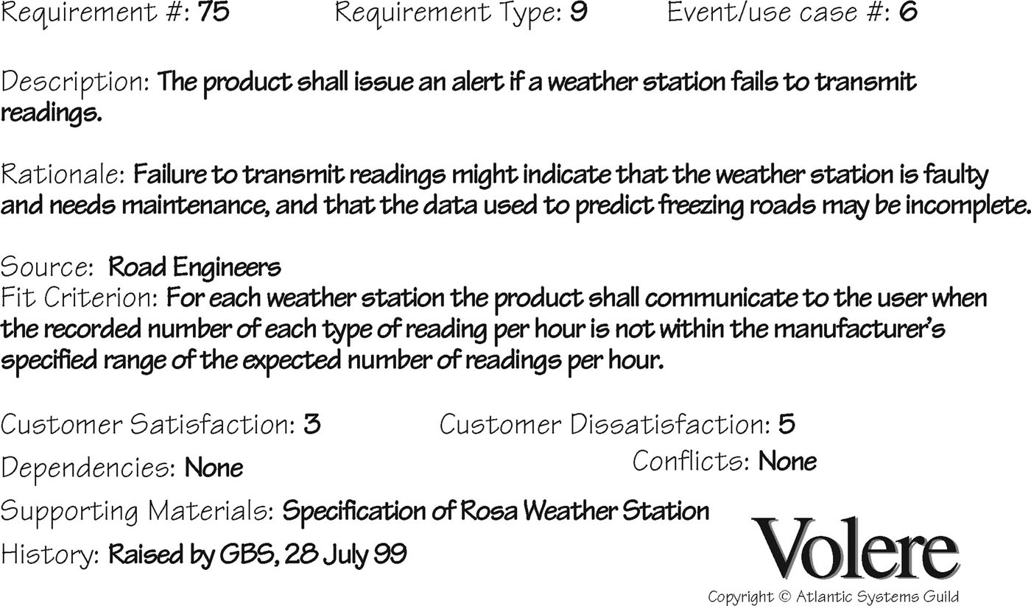
Volere shell

Slide 7
The seven product dimensions
Source: Gottesdiener and Gorman (2012), p.58. Used courtesy of Ellen Gottesdiener

Slide 8
Different kinds of requirements
Functional:
What the system should do
Data:
What kinds of data need to be stored?
How will they be stored (for example, database)?

Slide 9
Different kinds of requirements
Environment or context of use:
Physical: dusty? noisy? vibration? light? heat? humidity? …. (for example, in a hospital)
Social: collaboration and co-ordination, data sharing, distributed, synchronous or asynchronous, privacy
Organizational: user support, communications structure and infrastructure, availability of training
Technical: On what technologies will it run or need to be compatible?

Slide 10
Different kinds of requirements
Users — Who are they?
Characteristics: nationality, educational background, attitude to computers
System use: novice, expert, casual, frequent
Novice: prompted, constrained, clear
Expert: flexibility, access/power
Frequent: shortcuts
Casual/infrequent: clear menu paths
User profile

Slide 11
Different kinds of requirements
Usability goals
User experience goals
Different products have different requirements and may be implemented in different ways, for example, trustworthiness

Slide 12
Usable security
How to make security robust without detracting from user experience
If the usability of security is ignored, then security mechanisms will be circumvented
Passwords as an example
Too much advice about how to choose a password
Coping strategies may compromise security

Slide 13
Data gathering for requirements
Interviews, observation, and questionnaires
Studying documentation:
Procedures and rules are often written down in manuals
Good source of data about the steps involved in an activity and any regulations governing a task
Not to be used in isolation
Good for understanding legislation and getting background information
No stakeholder time, which is a limiting factor for other techniques
Researching similar products:
Good for prompting requirements

Slide 14
Combining data gathering
Direct observation, indirect observation, interviews, diaries, and surveys
Source: Hollis et al (2017), Figure 1. Used courtesy of Taylor and Francis

Slide 15
Combining data gathering
Diaries and interviews: multiple information devices
Interviews, think aloud evaluation, questionnaire, evaluation of working prototype: memory aid for traumatic brain injury
Studying documentation, evaluating other systems, user observation, and group interviews: ship’s maneuvering system
Ethnographic study, interviews, usability tests, and user participation: tabletop user interface for genomic data

Slide 16
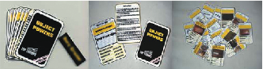
Using probes to engage with users
Many types of probe:
Designed to prompt users into action
For researchers to learn about users
Cultural probe:
Wallet containing postcards, maps, camera, photo album, and diary
Participants asked to answer questions using wallet contents
Design probe:
Form relates specifically to particular question and context, for example, Top Trumps probe
Source: Wallace et al. (2013) Figure 6. Reproduced with permission of ACM Publications.

Slide 17
Using probes to engage with users
Technology probe:
Toolkits, mobile phone apps, sensor-based monitoring, for example, M-Kulinda to alert participants about unexpected movement at home.
Provocative probe:
Technology probe designed to challenge norms and attitudes, for example, the Box to challenge domestic laundry practices
Source: Raptis et al. (2017). Reproduced with permission of ACM Publications.

Slide 18
Contextual Inquiry
Part of Contextual Design, but also used on its own to gather requirements
One-on-one field interviews (contextual interviews)
1.5 to 2 hours long
Focus on daily life at home or work relevant to the project
Uses a model of master (participant) and apprentice (researcher)
Four main principles:
Context: Going to the user, wherever they are, and seeing what they do as they do it
Partnership: User and interviewer explore user’s life together
Interpretation: Observations interpreted by user and interviewer together
Focus: Project focus to understand to what should be paid attention

Slide 19
Contextual Inquiry
Interview guided by “cool concepts” divided into two groups
Joy of life concepts:
How products make our lives richer and more fulfilling
Accomplish, connection, identity, and sensation
Joy of use concepts:
Describe impact of using the product
Direct in action, the hassle factor, and the learning delta
Interview in four parts
Overview, transition, main interview, and wrap-up
Following interview, interpretation session
Contextual design models are created or consolidated
Most relevant models are chosen by team, out of 10 suggested

Slide 20
Brainstorming for innovation
Include participants from a wide range of disciplines, with a broad range of experience
Don't ban silly stuff
Use catalysts for further inspiration
Keep records. Capture every idea, without censoring
Sharpen the focus
Use warm-up exercises and make the session fun

Slide 21
Bringing requirements to life
Augmenting the basic requirements expressed as stories, in Volere template, or in other form
Personas
Rich descriptions of typical users, not specific people
Scenarios
An informal narrative story, simple, ‘natural’, personal, and not generalizable

Slide 22
Personas
Capture a set of user characteristics (user profile)
Synthesized from real people based on user research
Typical, not idealized
Bring to life with name, characteristics, goals, and personal background
Relevant to product under development
Good persona helps designer with design decisions and reminds team about who will use the product
Develop a small set of personas with one primary

Slide 23
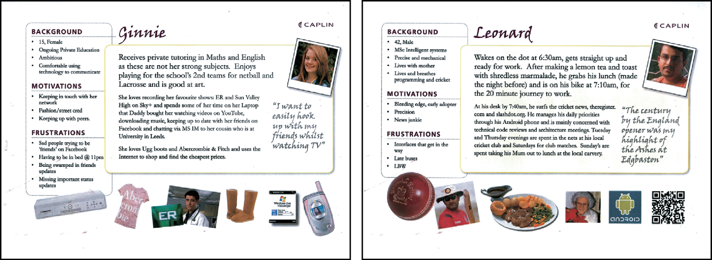
Example Persona #1

Slide 24
Example Persona #2
Developed using Xtensio Templates

Slide 25
Scenario for group travel organizer
“The Thomson family enjoy outdoor activities and want to try their hand at sailing this year. There are four family members: Sky (8 years old), Eamonn (12 years old), Claire (32), and Will (35). One evening after dinner they decide to start exploring the possibilities. They want to discuss the options together but Claire has to visit her elderly mother so will be joining the conversation from her mother’s house down the road. As a starting point, Will enters an idea they had been discussing over dinner – a sailing trip for four novices in the Mediterranean. The system supports users to log on from different locations and use different devices so that all members of the family can interact easily and comfortably with it wherever they are. The system's initial suggestion is a flotilla, where several crews (with various levels of experience) sail together on separate boats. Sky and Eamonn aren't very happy at the idea of going on vacation with a group of other people, even though the Thomson’s would have their own boat. The travel organizer shows them descriptions of flotillas from other children their ages and they are all very positive, so eventually, everyone agrees to explore flotilla opportunities. Will confirms this recommendation and asks for detailed options. As it's getting late, he asks for the details to be saved so everyone can consider them tomorrow. The travel organizer emails them a summary of the different options available.”

Slide 26
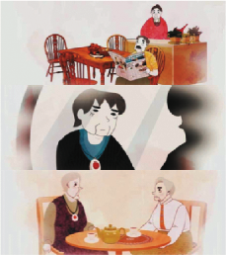
Scenarios
May be textual descriptions, animations, audio or video
Example animation scenarios
Source: Keirnan et al. (2015), Figure 1. Reproduced with permission of ACM Publications.

Slide 27
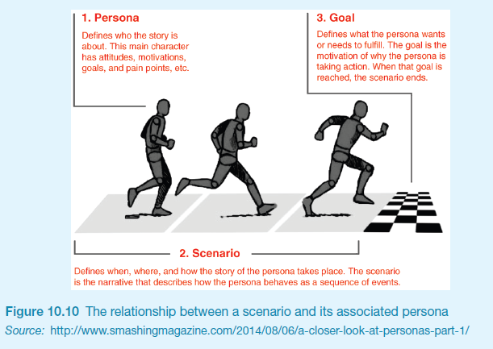
Scenarios and personas

Slide 28
Design fiction
Communicate a vision with future technologies
Fictional world in which ethics, emotions, and context can be explored without concrete constraints
Examples:
Privacy and surveillance
Exploring ethics
Scenarios are about “overcoming the monster,” while design fiction is about “quest”

Slide 29
Use cases
Focus on functional requirements and capture interaction
Can be used in design or to capture requirements
Use cases are step-by-step descriptions of interactions
Two styles:
Essential use cases: division of tasks, no implementation detail
Use case with normal and alternative courses: more detail

Slide 30
Example essential use case for travel organizer
RetrieveVisa
USER INTENTION SYSTEM RESPONSIBILITY
Find visa requirements Request destination and nationality
Supply required information Obtain appropriate visa info
Obtain copy of visa info Offer info in different formats
Choose suitable format Provide info in chosen format
Note: The user intention and system responsibility are offset vertically, showing a sequence of interactions

Slide 31
Use case for travel organizer
The product asks for the name of the destination country
The user provides the country’s name
The product checks that the country is valid
The product asks the user for their nationality
The user provides their nationality
The product checks the visa requirements of that country for a passport holder of the user’s nationality
The product provides the visa requirements
The product asks whether the user wants to share the visa requirements on social media
The user provides appropriate social media information

Slide 32
Alternative courses for travel organizer
Some alternative courses:
4. If the country name is invalid:
4.1: The product provides an error message
4.2: The product returns to step 1
6. If the nationality is invalid:
6.1: The product provides an error message
6.2: The product returns to step 4
7. If no information about visa requirements is found:
7.1: The product provides a suitable message
7.2: The product returns to step 1

Slide 33
Summary
A requirement is a statement about an intended product that specifies what it is expected to do or how it will perform.
Articulating requirements avoids miscommunication and supports technical developers and users to contribute.
Different kinds of requirements: functional, data, environmental (context of use), user characteristics, usability goals, and user experience goals.
Requirements data gathering uses: questionnaires, interviews, observation, studying documentation, and similar products
Scenarios are a story-based narrative to explore existing behavior, potential of new products, and futuristic visions of use.
Personas capture characteristics of typical users that are relevant to the product under development.
Scenarios and personas together bring requirements to life.
Use cases capture details about an existing or imagined interaction between users and the product.

